Slide 1
Code B - Data Science Integrated Internship Project DETECTING THE UNDETECTABLE
Phishing Website Detection using Machine Learning Techniques
Indumathi Rajendran

Slide 2

Phishing website detection – advanced machine learning techniques

Slide 3
introduction
Phishing continues to prove one of the most successful and effective ways for cybercriminals to defraud us and steal our personal and financial information. Our growing reliance on the internet to conduct much of our day-to-day business has provided fraudsters with the perfect environment to launch targeted phishing attacks. The phishing attacks taking place today are sophisticated and increasingly more difficult to spot. A study conducted by Intel found that 97% of security experts fail at identifying phishing emails from genuine emails.
Phishing is a rapidly growing threat in cyber world and causing billions of dollars in damage every year to internet users. It is an unlawful activity which uses a group of social engineering and technology to collect an Internet user's sensitive information. The identification of phishing techniques can be performed in various methods of communications like email, instant messages, pop-up messages, or at web page level.

Slide 4
SCOPE OF STUDY
This study explores the use of machine learning models trained on datasets obtained from open-source platforms to analyze website links and classify them as either phishing or legitimate. The trained model is integrated into a web-based application that enables users to input any URL and instantly receive a prediction regarding its legitimacy. The application is designed to be lightweight and compatible with a wide range of modern web browsers. It leverages key features from the URL structure such as length, presence of special characters, and domain patterns. The goal is to provide a quick, reliable, and user-friendly tool for enhancing online safety. Continuous improvements are planned by updating the model with newer datasets to adapt to evolving phishing tactics.

Slide 5
OBJECTIVE
The primary objective of a phishing website detection project is to identify and flag potentially malicious websites that attempt to steal user information or data. A phishing website is a common social engineering method that mimics trustful uniform resource locators (URLs) and webpages. This is achieved by analyzing website features, such as URL structure, content, and visual elements, to determine if a website is a phishing attempt. The goal is to protect users from falling victim to phishing attacks, which can result in financial losses, data breaches, and reputational damage. The main objective of this project is to train machine learning models on the dataset to predict phishing websites.
Beyond detection, this project also emphasizes real-time usability. By integrating the trained model into a web application, users can instantly verify the legitimacy of any link they encounter. This promotes cybersecurity awareness and provides a practical tool to stay protected against evolving online threats.

Slide 6
SIGNIFICANCE OF PHISHING WEBSITE DETECTION
Protecting Sensitive Information:
Preventing users from unknowingly revealing passwords, bank account details, and other personal information to criminals.
Avoiding Financial Loss:
Detecting and preventing fraudulent transactions and financial scams.
Mitigating Malware Infections:
Stopping users from being infected with malware that can be installed through phishing websites.
Maintaining Trust:
Protecting organizations and users from phishing attacks, which can damage their reputation and erode trust.
Improving Cybersecurity:
Enhancing overall cybersecurity by identifying and preventing phishing attacks, a common and effective cybercrime method.

Slide 7
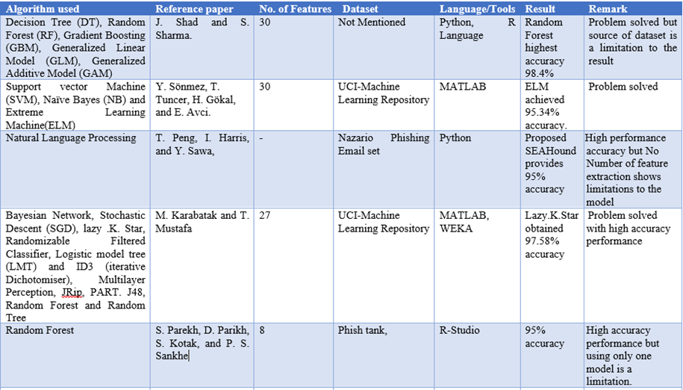
Literature review

Slide 8
Challenges in Phishing Detection
Sophistication of Attacks:
Attackers are increasingly using AI and advanced techniques to make phishing attacks appear legitimate and avoid detection.
Personalization and Targeting:
Spear phishing, where attacks are tailored to specific individuals or groups, are more challenging to detect than generic attacks.
False Positives:
Detection systems can sometimes flag legitimate emails as phishing attempts, leading to user frustration and potentially missed attacks.
Adaptability of Attackers:
Phishing tactics are constantly evolving, requiring ongoing adaptation and refinement of detection methods.
Lack of Awareness and Training:
Even with robust technical defenses, user awareness and training are crucial to prevent individuals from falling prey to phishing attacks.

Slide 9
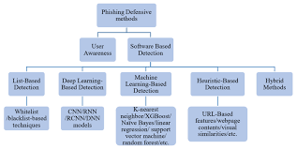
Phishing Defensive Methods
Email Filtering: Automatically blocks suspicious emails using spam and phishing detection algorithms.
URL Blacklisting: Maintains and checks against databases of known malicious websites.
Multi-Factor Authentication (MFA): Adds an extra layer of security, reducing risks even if credentials are compromised.
SSL Certificate Verification: Ensures users only interact with secure, verified websites.
User Awareness & Training: Educating users to recognize and avoid phishing attempts is one of the most effective defenses.

Slide 10
Potential Solutions and Mitigation Strategies
User Education and Training:
Educating users about phishing tactics and best practices, such as verifying links and being cautious about unusual requests, is crucial.
Robust Technical Défense:
Implementing strong email security measures, including spam filters, antimalware software, and website security tools, can help prevent phishing attacks.
Machine Learning and AI:
Using machine learning algorithms to analyze email content, website features, and user behavior can help identify and block phishing attempts.
Multi-layered Approach:
A combination of technical defenses, user awareness, and ongoing monitoring is necessary to effectively mitigate phishing risks.
Collaboration and Information Sharing:
Sharing information about phishing attacks and best practices among organizations and security professionals can help strengthen overall defenses.

Slide 11


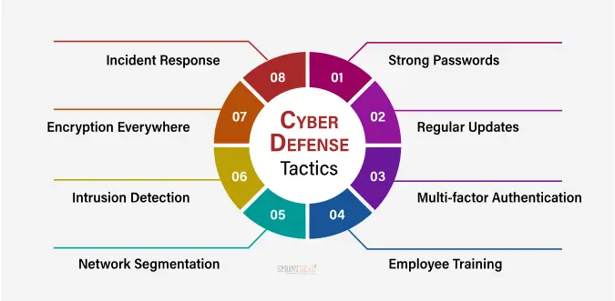

Slide 12
IDENTIFICATION OF A Fraudulent URL
A fraudulent or phishing domain often displays suspicious characteristics that distinguish it from legitimate websites. Common warning signs include:
Misspelled domain names.
Wrong or unusual top-level domains.
Blending of legitimate and fake elements in a single URL.
Excessively long URLs that try to hide malicious content in plain sight.
URLs that use only IP addresses instead of domain names.
Low or no page rank, indicating lack of credibility or recognition.
Recently registered domains, which are often flagged as suspicious.
Presence of multiple special characters, dashes, or numbers in unnatural places.
HTTPS missing or invalid SSL certificates, especially for login/payment pages.
Unusual URL paths or parameters that don’t match the brand or site behavior.

Slide 13

DESIGN METHODOLOGY
An extensive review was done on existing works of literature and machine learning models on detecting phishing websites to best decide the classification models to solve the problem of detecting phishing websites.
To ensure robustness, the selected models were trained and validated using publicly available datasets containing both phishing and legitimate URLs. Key performance metrics such as accuracy, precision, recall, and F1-score were used to evaluate the models. The final model was chosen based on its generalization ability and low false-positive rate, making it reliable for real-world deployment.

Slide 14

Machine Learning Design Approach
1. Dataset Collection & Preprocessing
Collected phishing & legitimate URLs from open-source datasets
Performed Exploratory Data Analysis (EDA)
Cleaned, encoded, and scaled features for model input
2. Model Selection & Development
Split data into training and test sets
Applied ML algorithms: Logistic Regression, KNN, Decision Tree, Random Forest, SVM, AdaBoost, XGBoost
Evaluated using accuracy, precision, recall, F1-score
3. Model Comparison & Optimization
Compared models to find the best performer
Used cross-validation & hyperparameter tuning
Selected final model based on overall performance

Slide 15
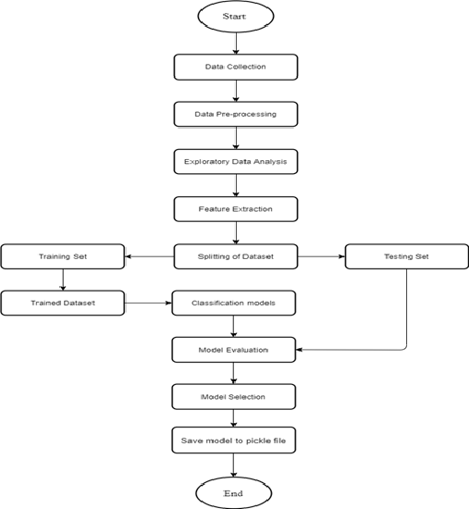

Machine learning Process

Slide 16
Dataset overview
The phishing detection dataset comprising 11,430 URLs with 87 features is a comprehensive resource for training machine learning models to identify phishing websites. These features are categorized into three main classes:
1. URL Structure and Syntax (56 features)
2. Web Page Content (24 features)
3. External Services (7 features)
Each feature provides insights into different aspects of a website that may indicate phishing activity.
These features, when combined, help in identifying and classifying whether a given URL is phishing or not. The use of URL structure, page content, and external services provides a holistic view of the website, enhancing the model’s ability to detect phishing activities accurately.
The EDA revealed key insights into the dataset, including important features for phishing detection and balanced data. These findings will help guide the preprocessing steps for model training and further improve phishing detection accuracy.

Slide 17
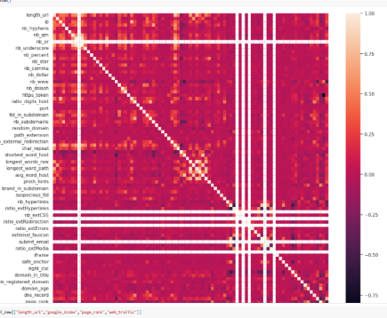
Feature correlation
Feature correlation measures the strength and direction of a relationship between two variables.
In machine learning, highly correlated features may carry redundant information, which can affect model performance.
Identifying and removing strongly correlated features helps in reducing multicollinearity and improving model interpretability.
A correlation matrix or heatmap is commonly used to visualize the relationships among features.

Slide 18
Model selection & evaluation
This project frames phishing detection as a binary classification task—where each URL is categorized as either phishing (1) or legitimate (0).
The following classification algorithms were implemented and evaluated:
Logistic Regression
K-Nearest Neighbors (KNN)
Decision Trees
Random Forest
Support Vector Machine (SVM)
AdaBoost
XGBoost
Among all the models, XGBoost demonstrated the highest performance in terms of accuracy and ROC-AUC scores.Its effectiveness was further improved using hyperparameter tuning via GridSearchCV, optimizing it for better generalization. Final evaluation shows XGBoost as the most reliable model for phishing URL detection. The tuned model is now ready for real-time deployment in the web-based detection system.

Slide 19
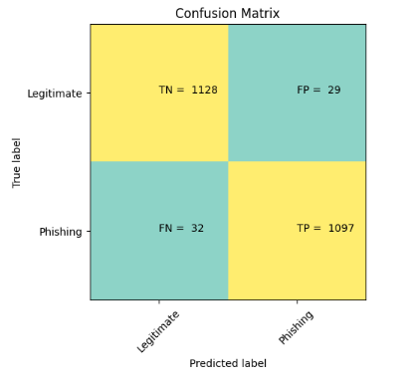
XGBOOST CLASSIFIER
XGBoost (Extreme Gradient Boosting) is a powerful and scalable machine learning algorithm based on gradient boosting.
It builds an ensemble of decision trees sequentially, where each new tree corrects errors made by the previous ones.
Known for its high accuracy, speed, and regularization, XGBoost often outperforms other classifiers in structured data problems.
It handles missing values, prevents overfitting with built-in L1 and L2 regularization, and supports parallel processing.
Ideal for classification tasks like phishing detection due to its robustness and predictive strength.

Slide 20
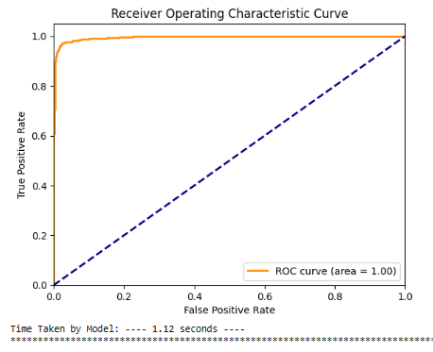
ROC - AUC CURVE
ROC (Receiver Operating Characteristic) curve is a graphical plot that shows the performance of a classification model at various threshold settings.
It plots the True Positive Rate (TPR) against the False Positive Rate (FPR).
AUC (Area Under the Curve) represents the degree of separability — the higher the AUC, the better the model is at distinguishing between classes.
An AUC of 1.0 indicates perfect classification, while 0.5 suggests random guessing.
It is a widely used metric for evaluating binary classification models, especially in imbalanced datasets.

Slide 21
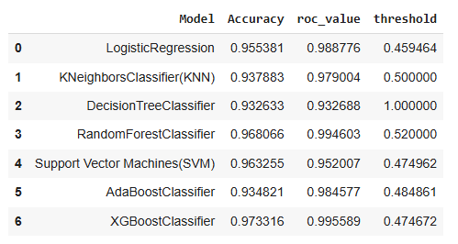
Model evaluation
All selected machine learning models were evaluated using accuracy as the primary performance metric. The bar chart below illustrates both the training and testing accuracy for each model.
From the visual analysis, it is evident that the XGBoost classifier outperforms the others, delivering superior accuracy and balanced generalization on both training and testing sets.
Due to its consistent performance and robustness, the XGBoost model was selected and saved for deployment and integration into the web-based phishing detection application.
Additional metrics like ROC-AUC, precision, and recall were also considered to validate the reliability of the chosen model.

Slide 22
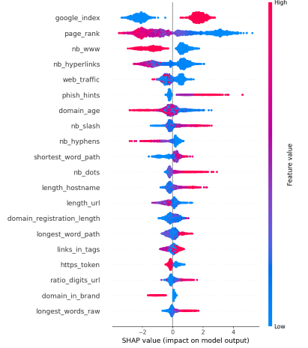
SHAP ANALYSIS-SUMMARY PLOT
The SHAP (SHapley Additive exPlanations) summary plot provides a global interpretability view of the model's predictions by showing how each feature contributes to the output.
In the phishing detection model, the plot highlights which URL and content-based features most strongly influence the model's decision to classify a website as phishing or legitimate.
Features on the top have the highest impact on predictions.
Color represents feature value (red = high, blue = low).
Horizontal spread shows variation in feature influence across samples.
This helps in understanding model behavior, identifying key phishing indicators, and building trust in the model's decisions.

Slide 23
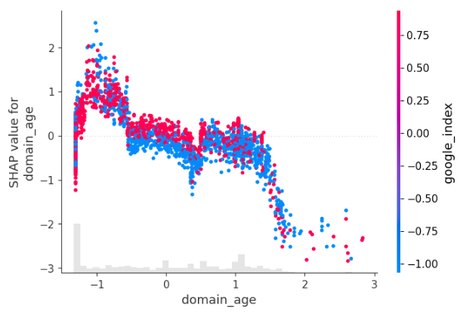
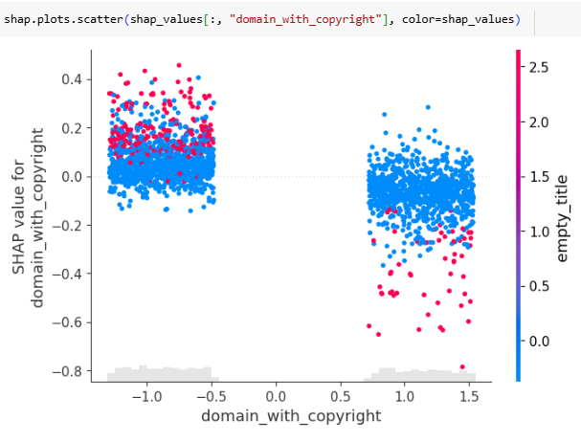
SHAP ANALYSIS – DEPENDENCE PLOT
The SHAP dependence plot visualizes the relationship between a specific feature and its corresponding SHAP value, showing how that feature contributes to the model’s prediction. It is particularly useful in understanding the magnitude and direction of influence a feature has.
In the context of phishing website detection:
It demonstrates how changes in a feature (e.g., number of special characters in the URL) affect the likelihood of a site being classified as phishing.
The color gradient indicates the value of a second feature, helping capture feature interaction effects.
It uncovers non-linear relationships that would otherwise be hidden, offering a clearer understanding of model decisions.
By analyzing these plots, developers and stakeholders can interpret the model’s logic, enhance transparency, and potentially refine feature engineering for better accuracy.

Slide 24
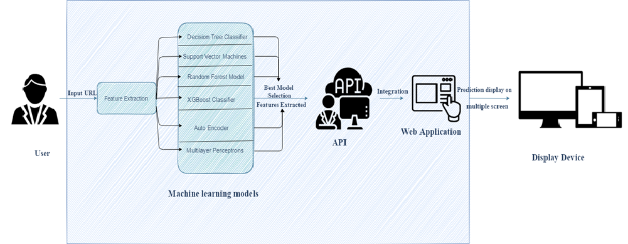
Architectural design of proposed system
The proposed system architecture for phishing URL detection is composed of several interconnected modules to ensure seamless operation from data input to result visualization.
It begins with data preprocessing, where input URLs are transformed into meaningful features. These features feed into the machine learning models, with XGBoost selected for deployment due to its superior performance.

Slide 25
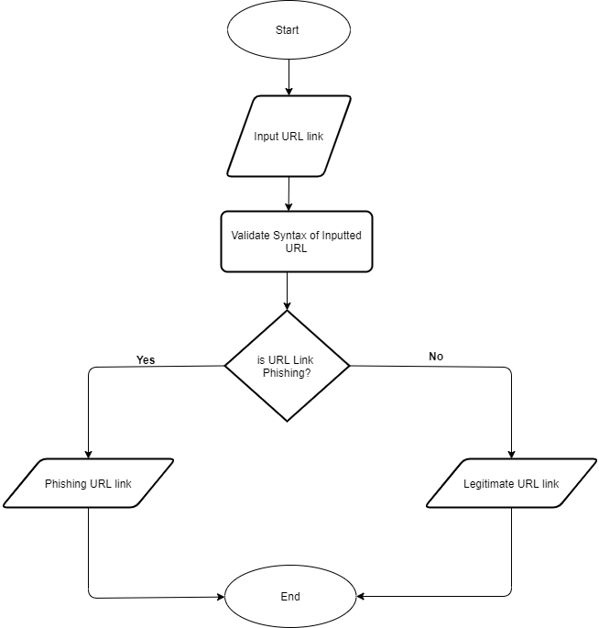
FLOW CHART OF WEB APPLICATION
1. Web Application Development
Designed a user-friendly, browser-compatible web UI
Enabled URL input & prediction display
Built using HTML, CSS, JavaScript (or React)
2. Model Integration
Integrated final model into the backend (Flask/Django)
Connected model predictions to the frontend
Ensured real-time detection functionality
3. Deployment & Testing
Deployed web app to a live server
Tested for performance & user feedback
Ensured system stability and speed

Slide 26
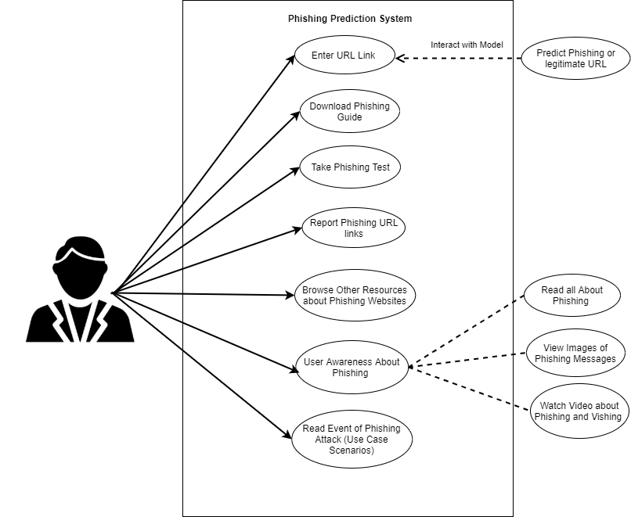
Use case of web application
The trained model is wrapped using a RESTful API, which acts as a communication layer between the backend model and the web application. The web application provides a user-friendly interface where users can input URLs and view the predictions in real time.
The final output is rendered on a display device, such as a desktop or mobile screen, enabling users to instantly determine whether a URL is phishing or legitimate.
Additionally, explainability features such as SHAP visualizations can be integrated into the web interface for transparency.
This modular architecture supports scalability, real-time detection, and easy integration into existing security systems.

Slide 27
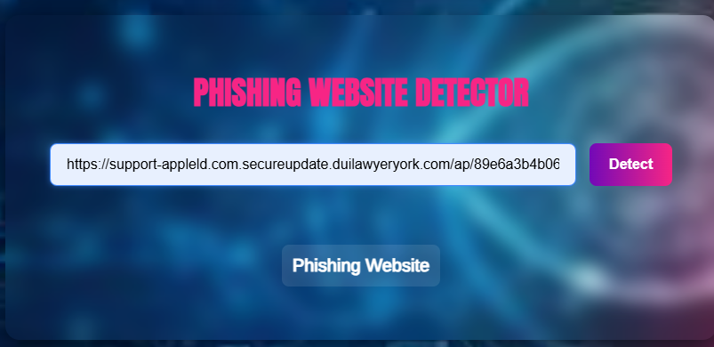
Front-End Web UI: Phishing URL Detector
The front-end web user interface is designed for simplicity and ease of use, enabling users to quickly verify the authenticity of a URL. The interface includes an input field where users can paste or type a URL, and a “Detect" button to trigger analysis.

Slide 28
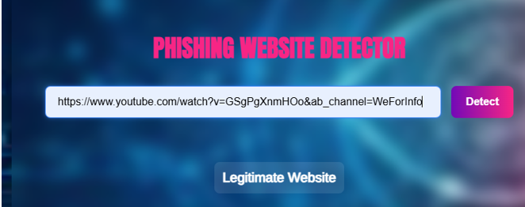
Front-End Web UI: Phishing URL Detector
Once submitted, the system interacts with the backend model via API and displays the prediction results — either “Phishing” or “Legitimate” — along with additional insights like SHAP-based feature importance.
The UI is responsive and accessible across devices, ensuring seamless experience for all users. It plays a crucial role in making advanced phishing detection models easily accessible without requiring any technical knowledge.

Slide 29
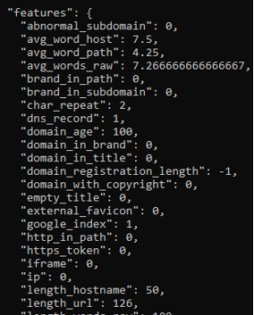
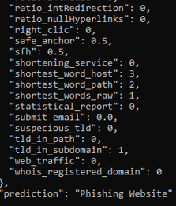
API PREDICT/EXPLAIN END POINTS
🔹 /api/predict: This endpoint receives a URL input from the front-end and processes it through the trained machine learning model (e.g., XGBoost). It returns a prediction indicating whether the URL is phishing or legitimate. The response is quick and suitable for real-time threat detection.
🔹 /api/explain: This endpoint provides interpretability. It uses SHAP (SHapley Additive exPlanations) values to highlight which features contributed most to the prediction. This is useful for understanding the model’s reasoning and increasing trust in its decisions.

Slide 30

The Future of Phishing Detection
AI-Driven Detection
Adaptive models learn from new attacks. Generative Adversarial Networks (GANs) simulate attacks. Reinforcement Learning optimizes detection strategies.
The future of phishing detection lies in the integration of AI-powered models, real-time threat intelligence, and adaptive learning systems. With the rise of sophisticated phishing techniques like deepfake emails and AI-generated URLs, traditional methods are becoming less effective
Human-AI Collaboration
Combines machine learning with human expertise. Security analysts validate AI-flagged websites. This improves accuracy and reduces false positives.
Future systems will leverage natural language understanding, behavioral analysis, and continuous model retraining to detect subtle and evolving threats. Moreover, browser-level protection, cloud-based APIs, and user-awareness tools will work together to provide multi-layered, proactive defense mechanisms.

Slide 31
Final Project Deployment
Deployed project link:
https://github.com/Sai-indu/Phishing-Website-Detection

Slide 32
THANK YOU

